Slide 1
Outline
Pollination is important
we think as a positive relationship
But in reality is a balance between positive and negative
Therefore We want to understand the competition
There trade off between the number of partners and the benefit
But we don’t know if that a thing? And how it relates to quantity and quality
Therefore we do that here
But its not possible because you need lots of data
We collect four aspects of pollination at community level
We bootstrap set of models
Construct quantity and quality
It’s a thing but not a biggie

Slide 2
the pollination
trade-off
Annual Biology Conference 2018
Fernando Cagua
Hugo Marrero
Jason Tylianakis
Daniel Stouffer
Notes:
important for the maintenance of biodiversity
between 7 and 30% of crops production worldwide depends to some extent on pollination

Slide 3
the pollination
is
mutualism
but also
competition
Notes:
we think about pollination as mutualism eg …
but poillination has also costs like for example when pollen from a species is lost to the wrong flowers or when a species receives pollen from the worng species decreasing reproductive siccess
as soon as you introduce costs you introduce competition
the thing is that in the context of pollination we understand very little about how plants compete for pollen and how that affect what we know about pollination communities

Slide 4
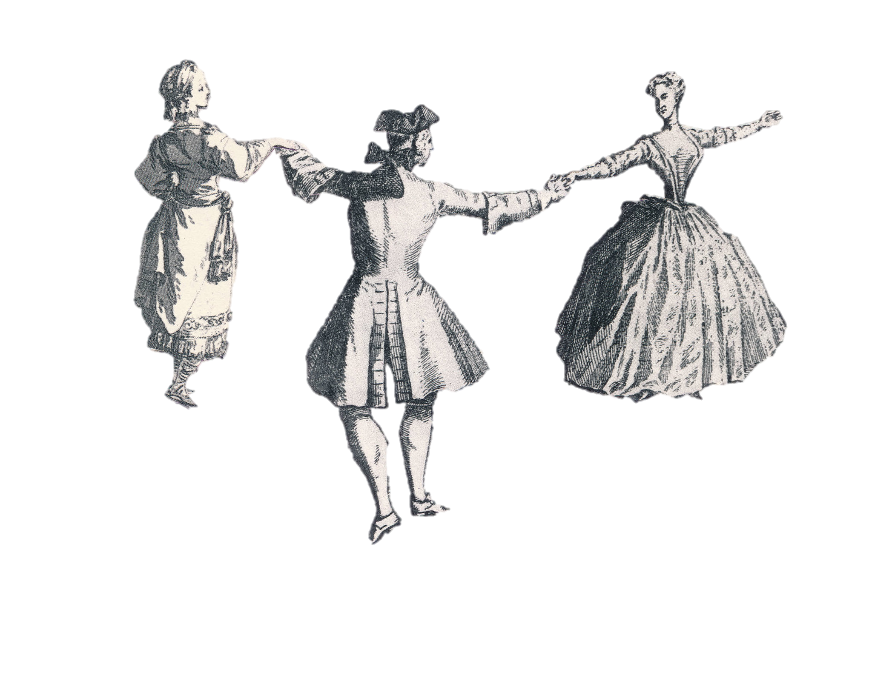
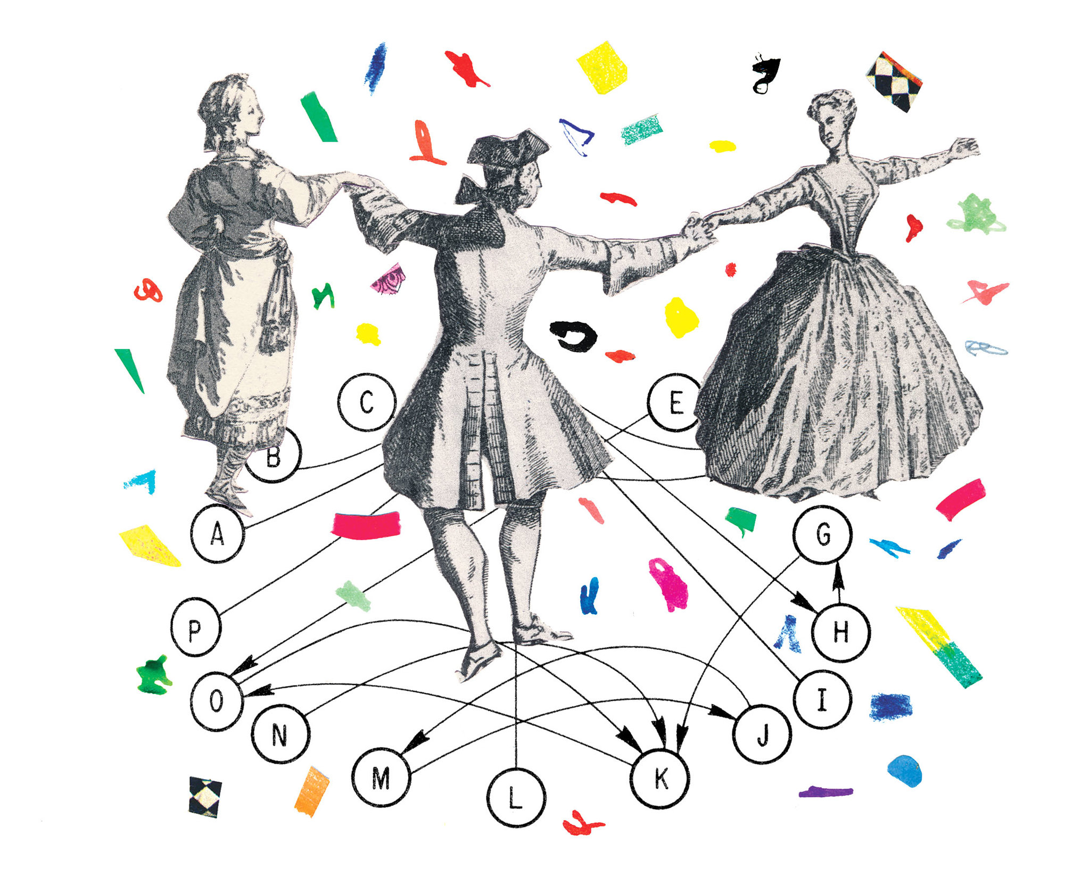
trade-off?
number of interactions vs. pollination service
is there a
in a community ?
Illustration: Joanna Neborsky – The New York Times
Notes:
the most intuitive factor determining competition is what we call here “the mutualistic trade off”

Slide 5
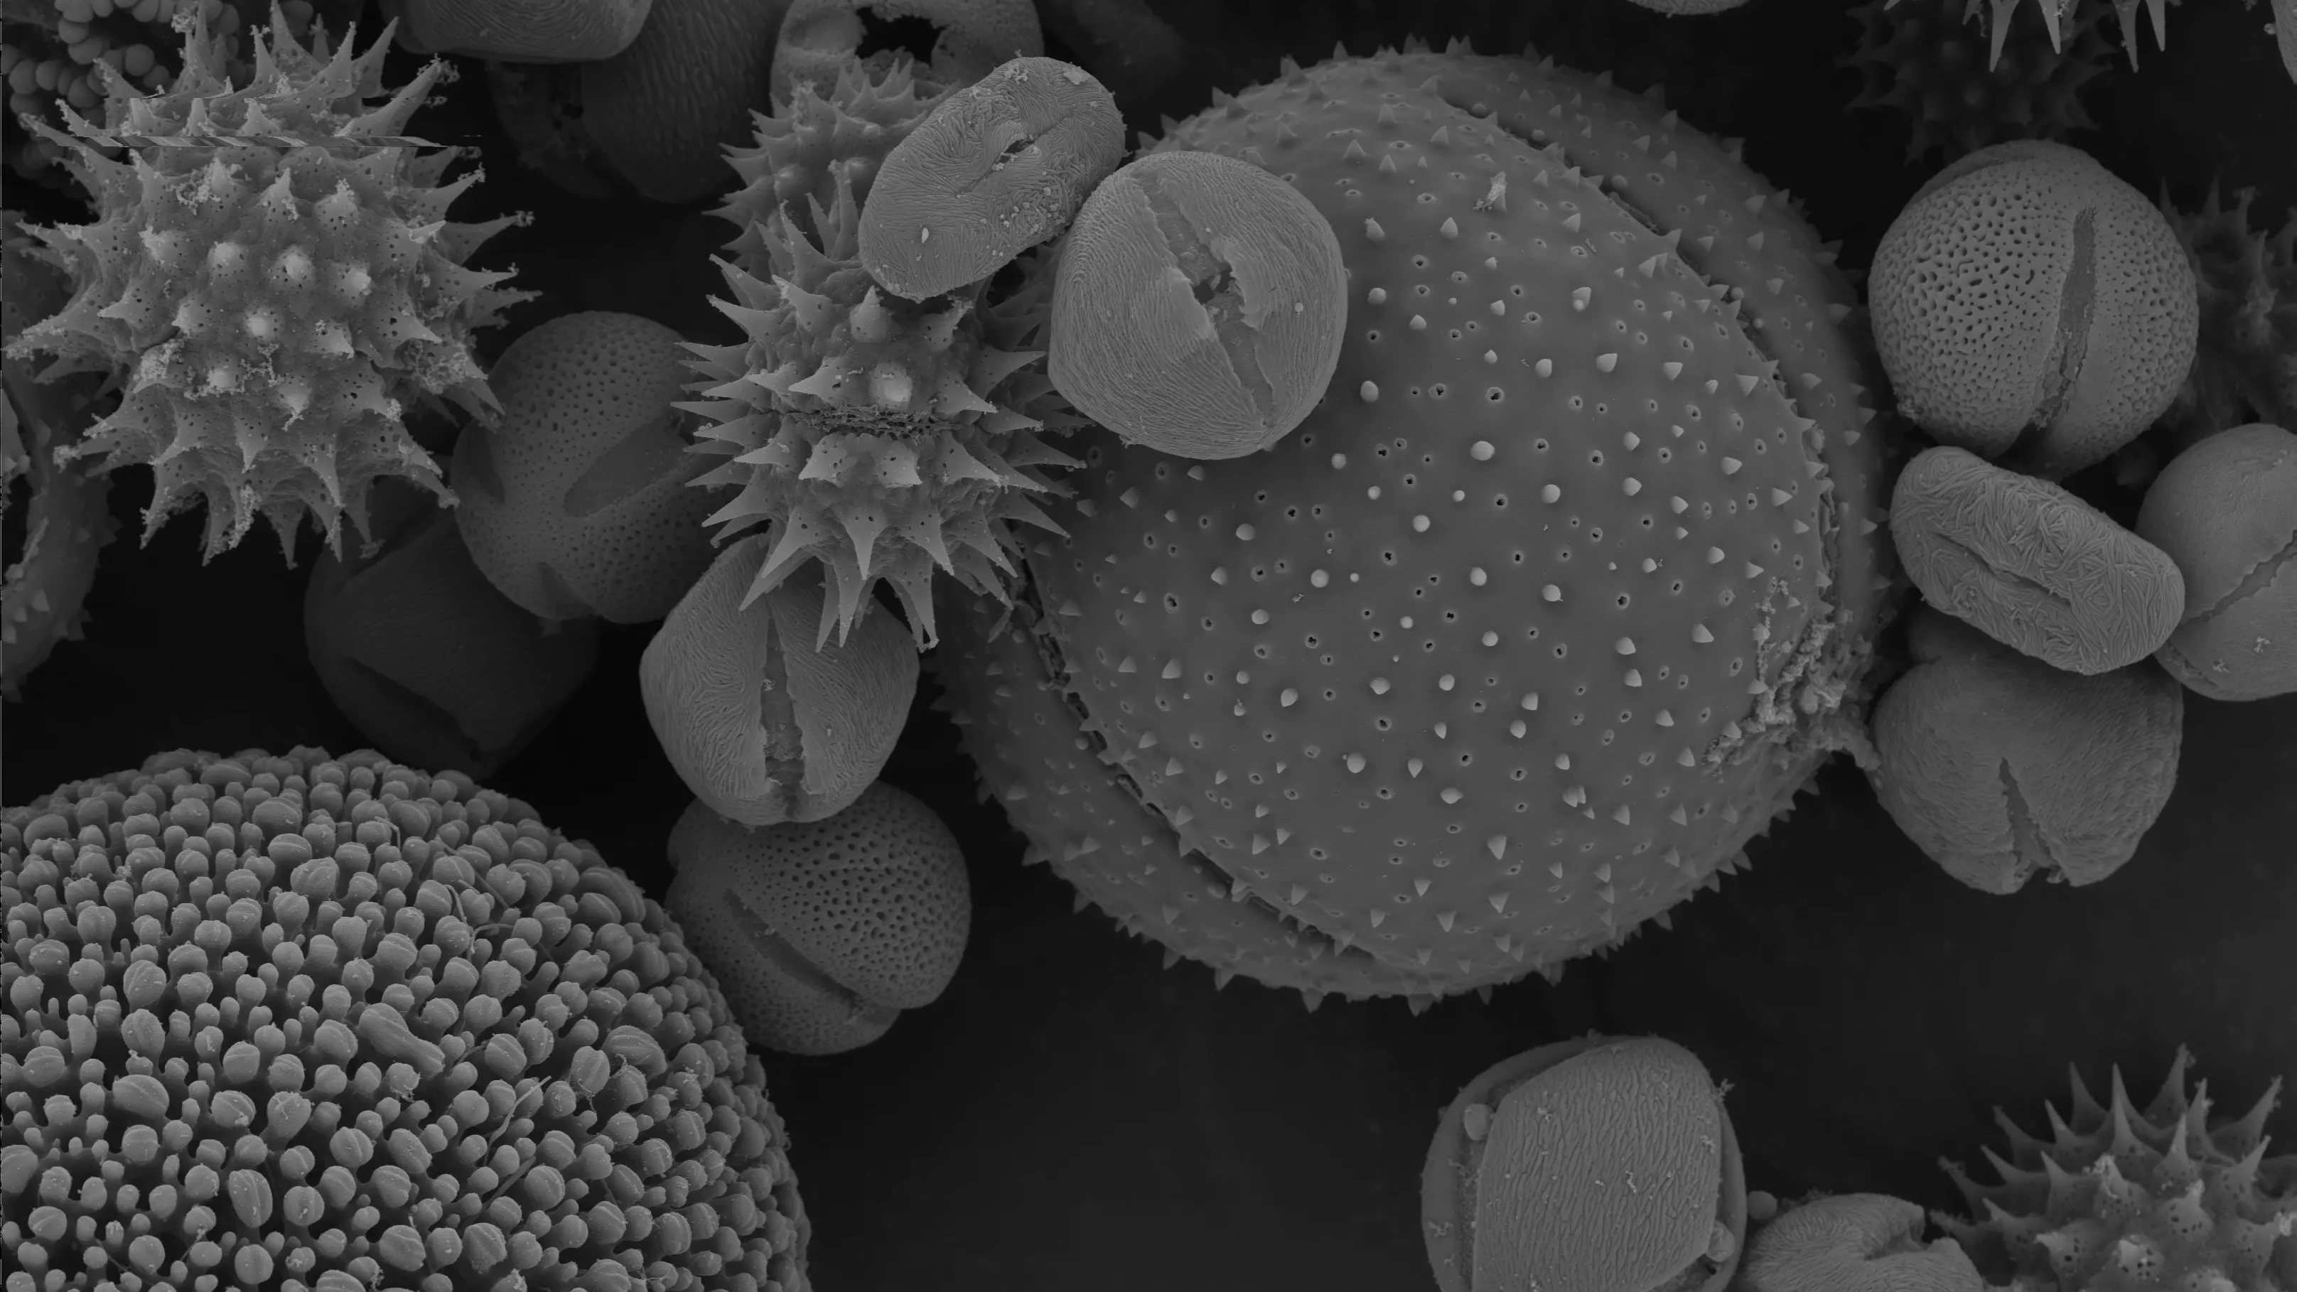
we need to measure the
we measure the
quantity & quality of the
pollination service
Photo: Dartmouth Electron Microscope Facility

Slide 6
we measure the
conspecific &
heterospecific
pollen on stigmas
Photo: Martin Oeggerli – National Geographic
Photo: Dartmouth Electron Microscope Facility

Slide 7
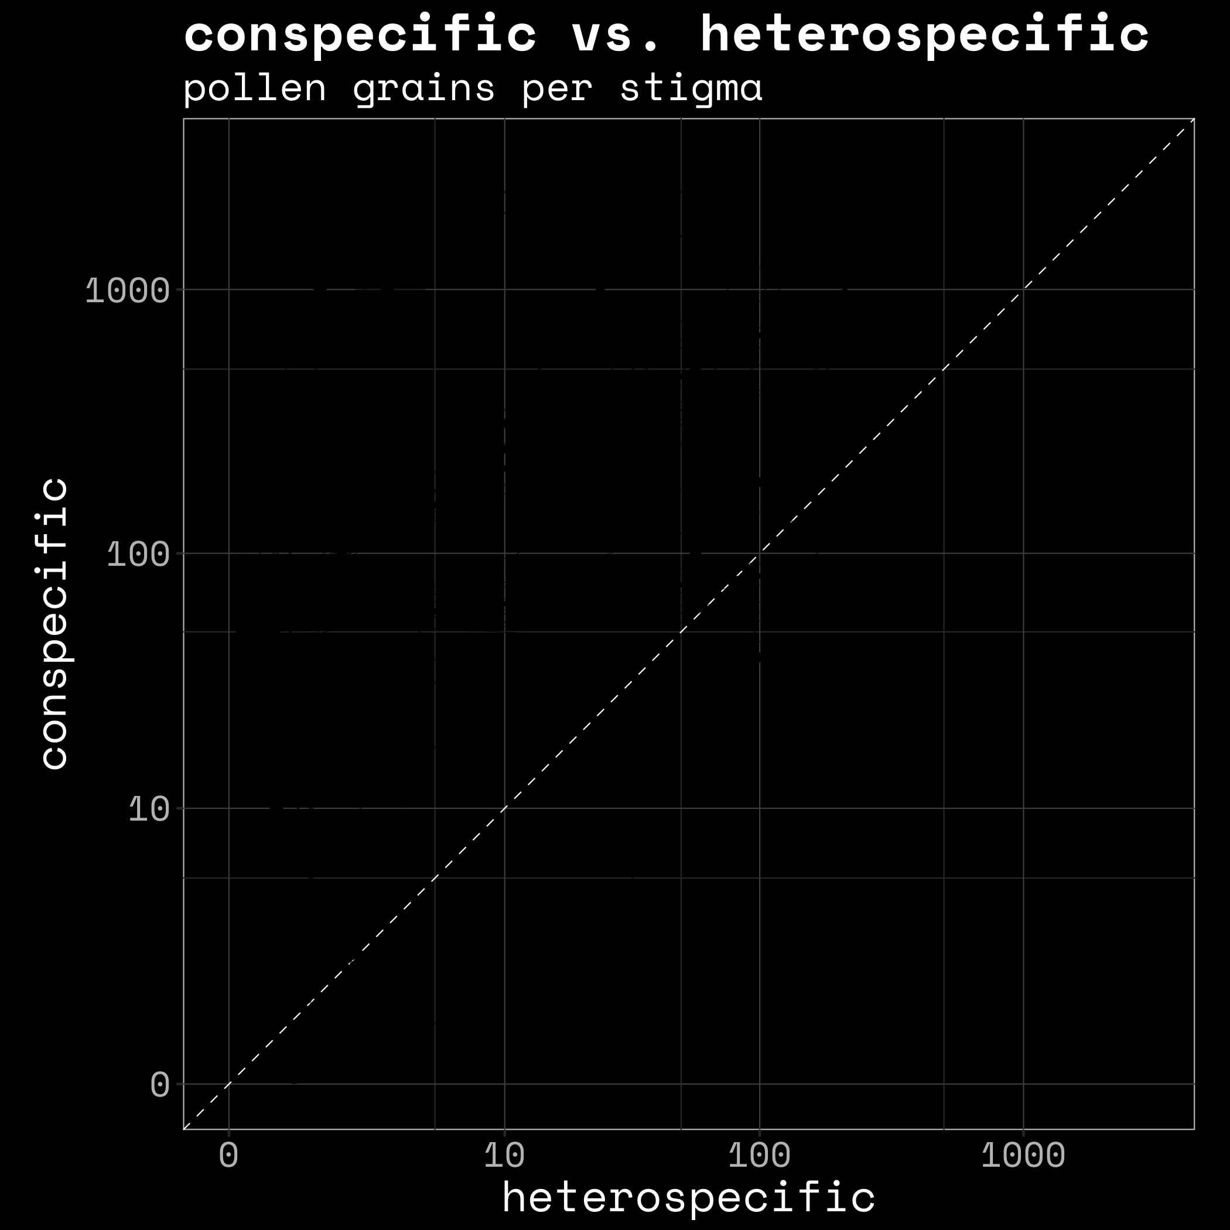
quantity
quality
Photo: Martin Oeggerli – National Geographic
Notes:
In each transect we counted the pollen in the stigmas and looked at wether the pollen was conspecific or heterospecific

Slide 8
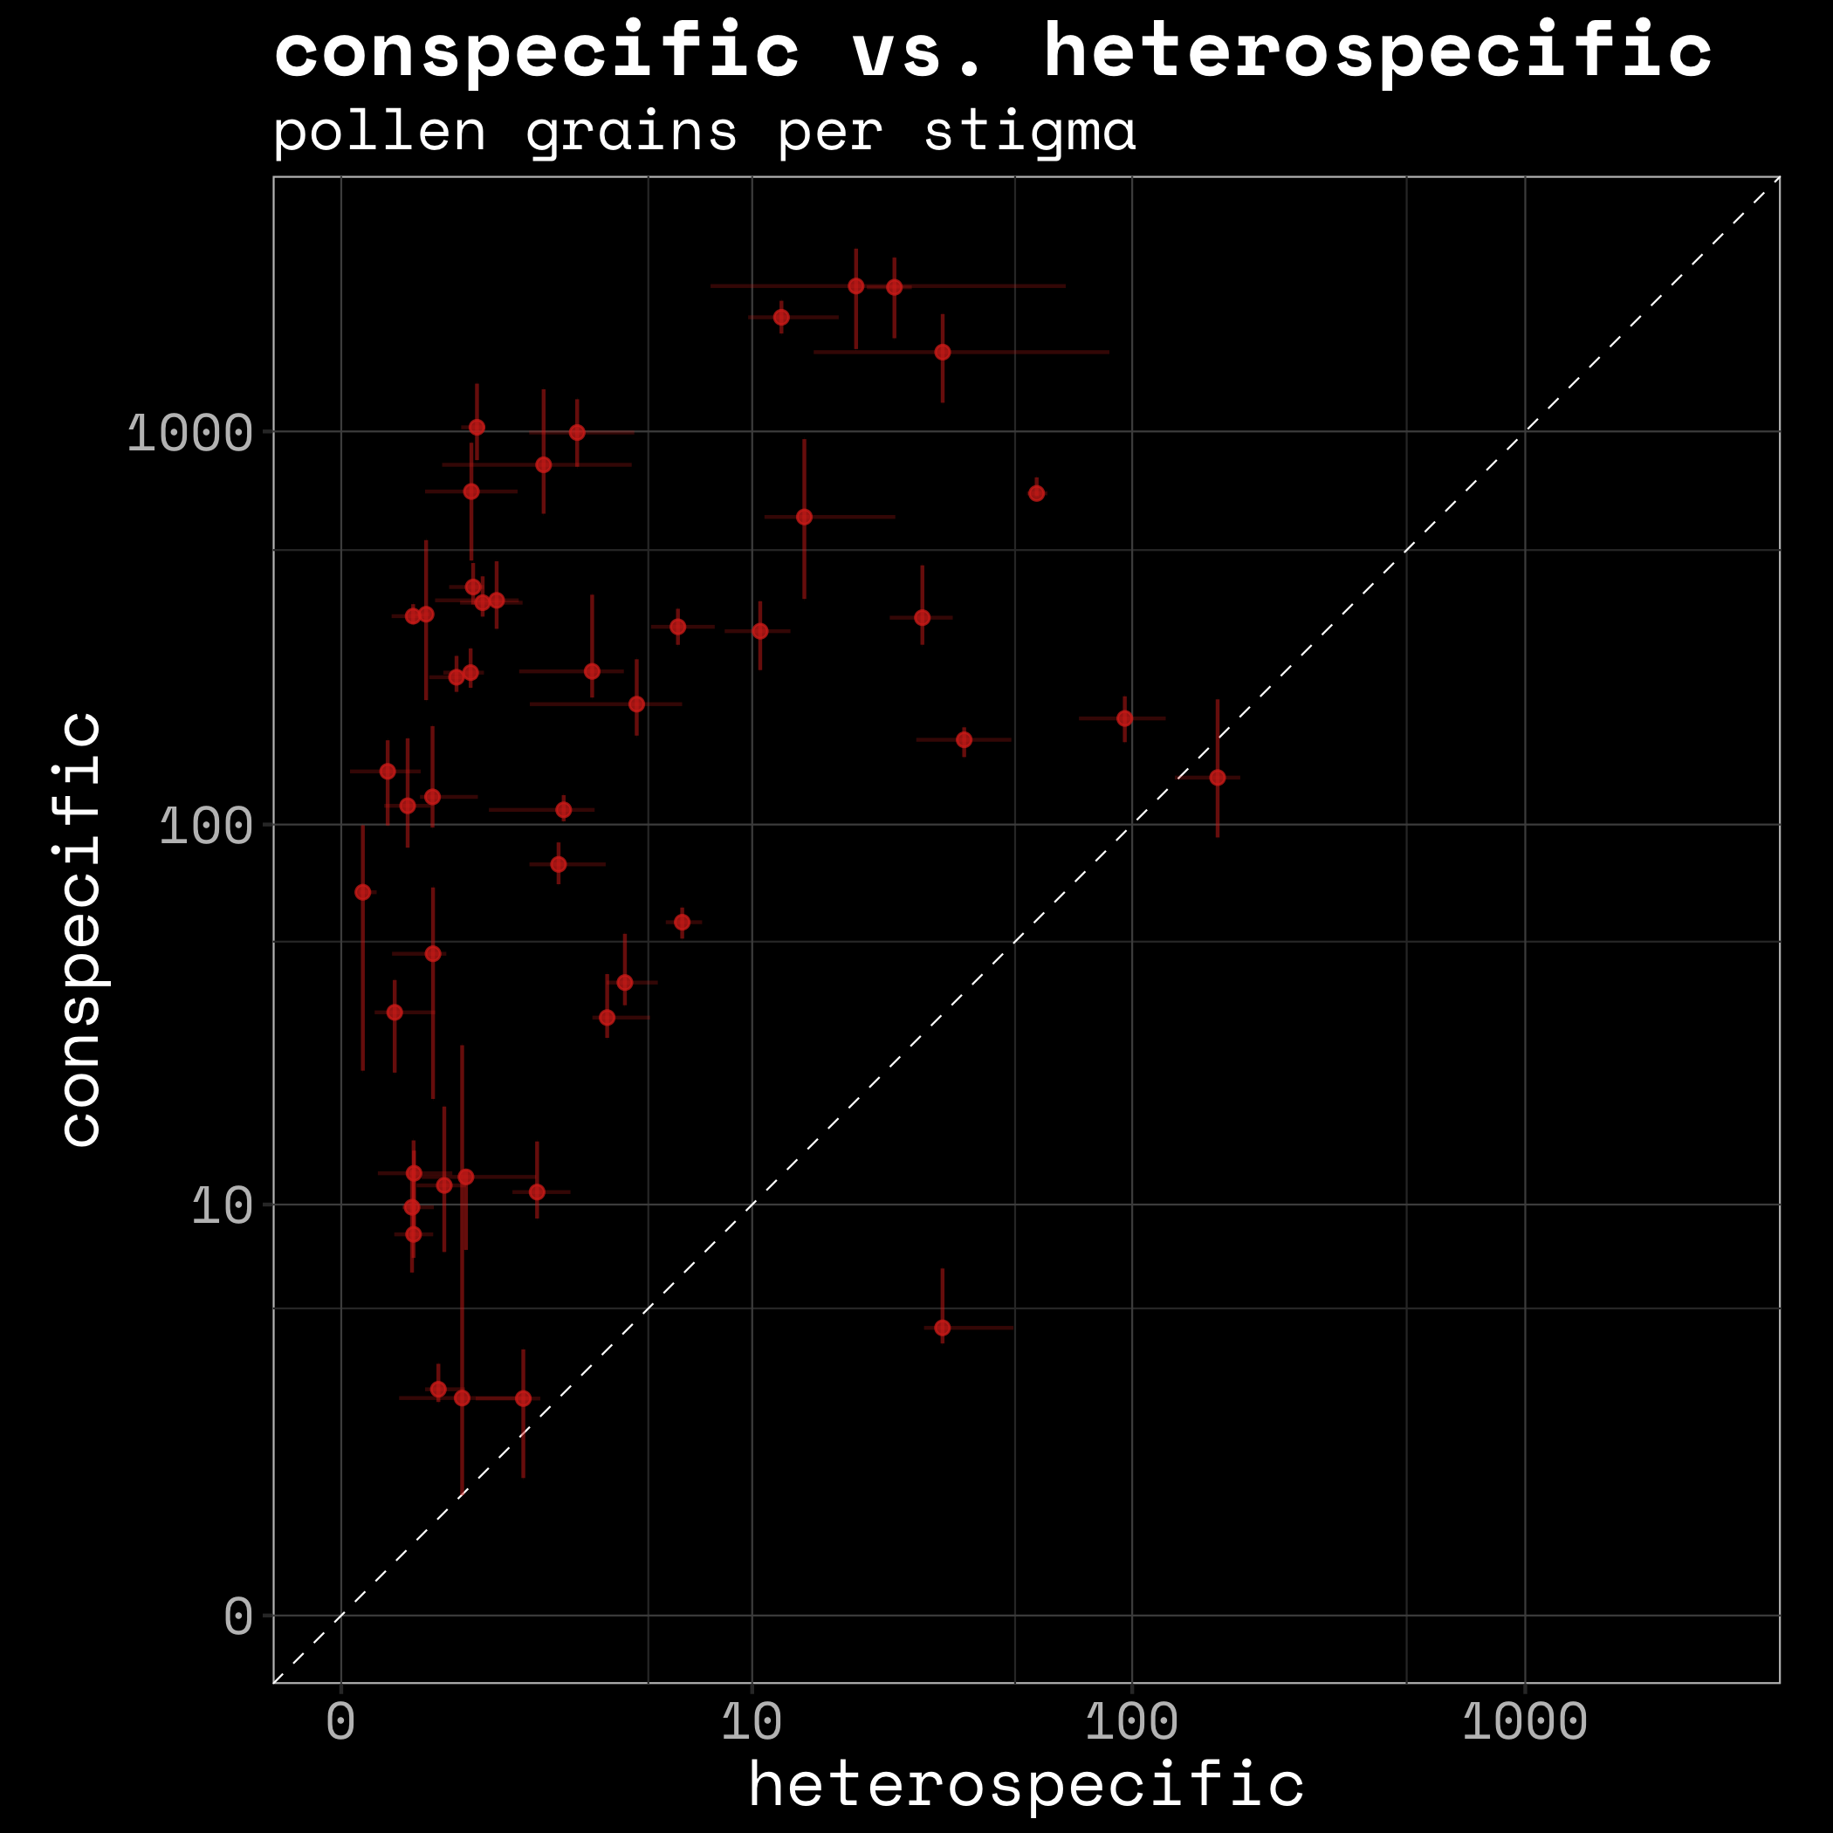

Photo: Martin Oeggerli – National Geographic
Notes:
In each transect we counted the pollen in the stigmas and looked at wether the pollen was conspecific or heterospecific

Slide 9
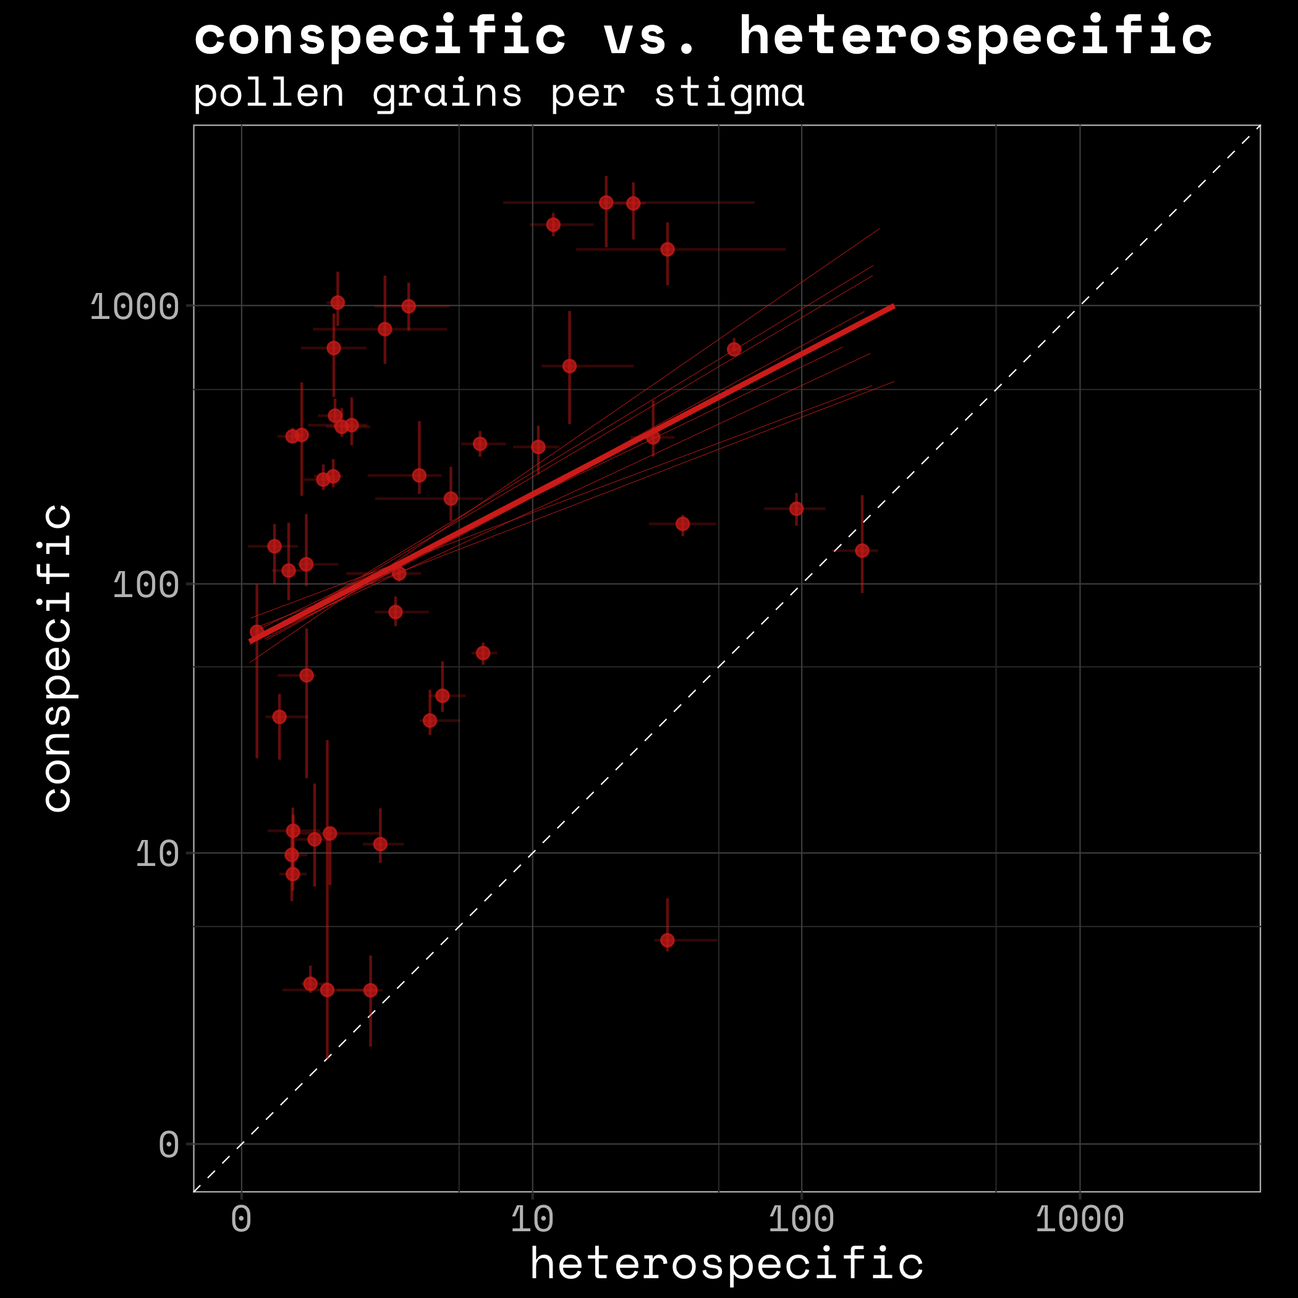
Photo: Martin Oeggerli – National Geographic
Notes:
In each transect we counted the pollen in the stigmas and looked at wether the pollen was conspecific or heterospecific

Slide 10
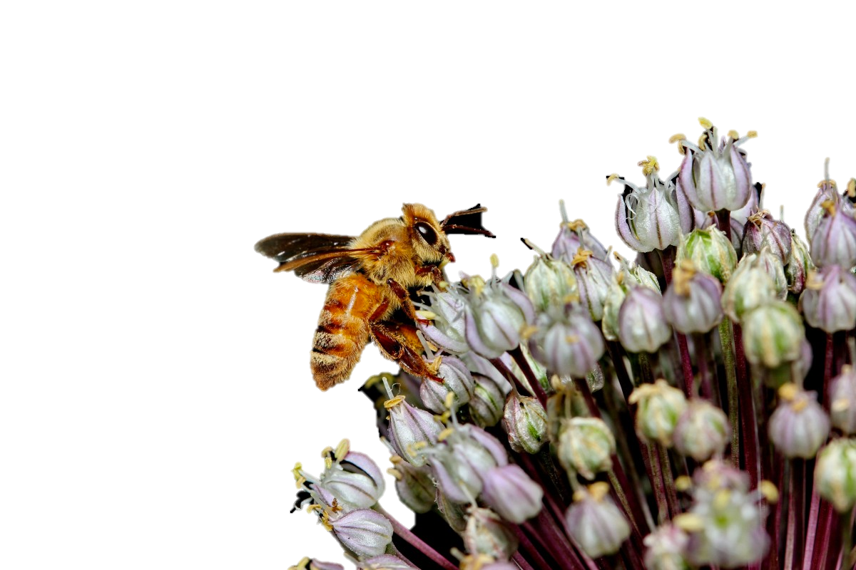
4 explanatory variables
- degree
→ to evaluate the trade-off

Slide 11
4 explanatory variables
- degree
- abundance
→ density effects
- share in pollen pool

Slide 12
4 explanatory variables
- degree
- abundance
- share in pollen pool
traits → phenology
phylogeny
- functional originality
Photo: Claude W. Hamilton

Slide 13
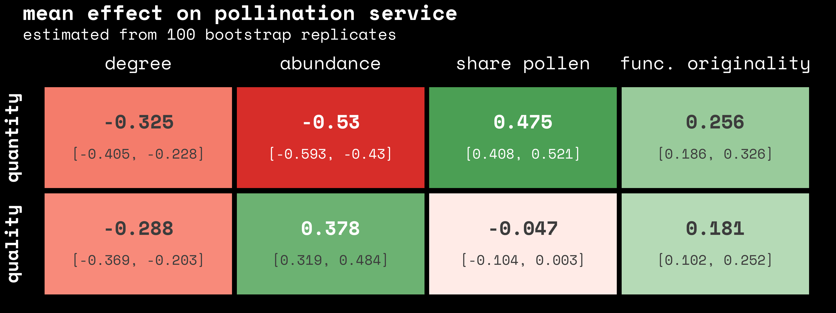
negative effect
neutral effect
positive effect

Slide 17
relative importance
0.4
0.9
1.0
0.5

Slide 18
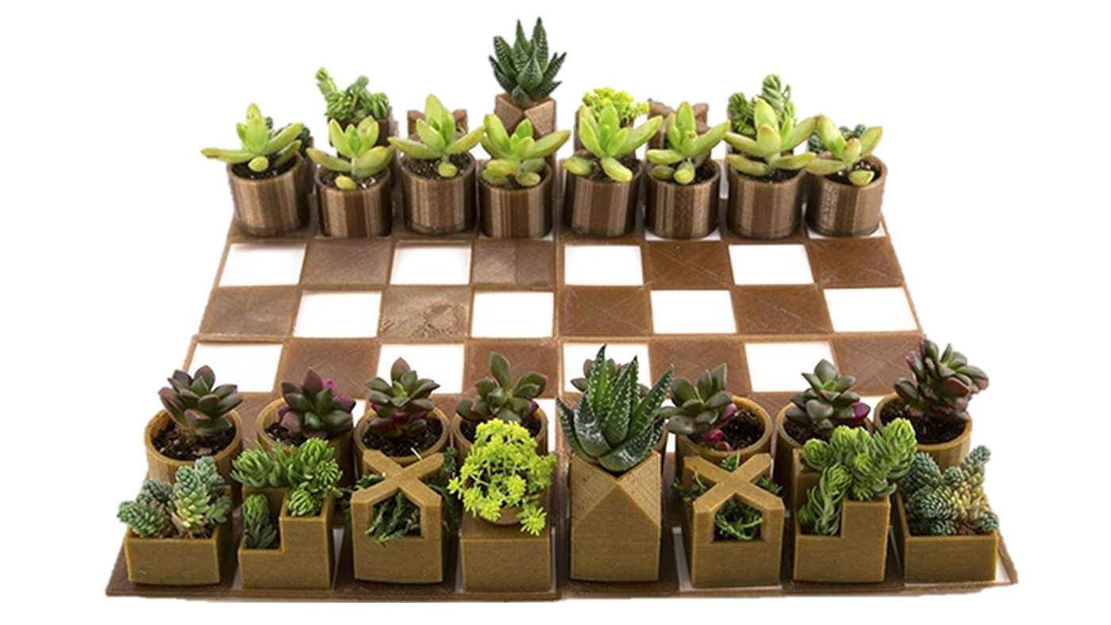
what is the strategy?
Photo: Justin Netti

Slide 19
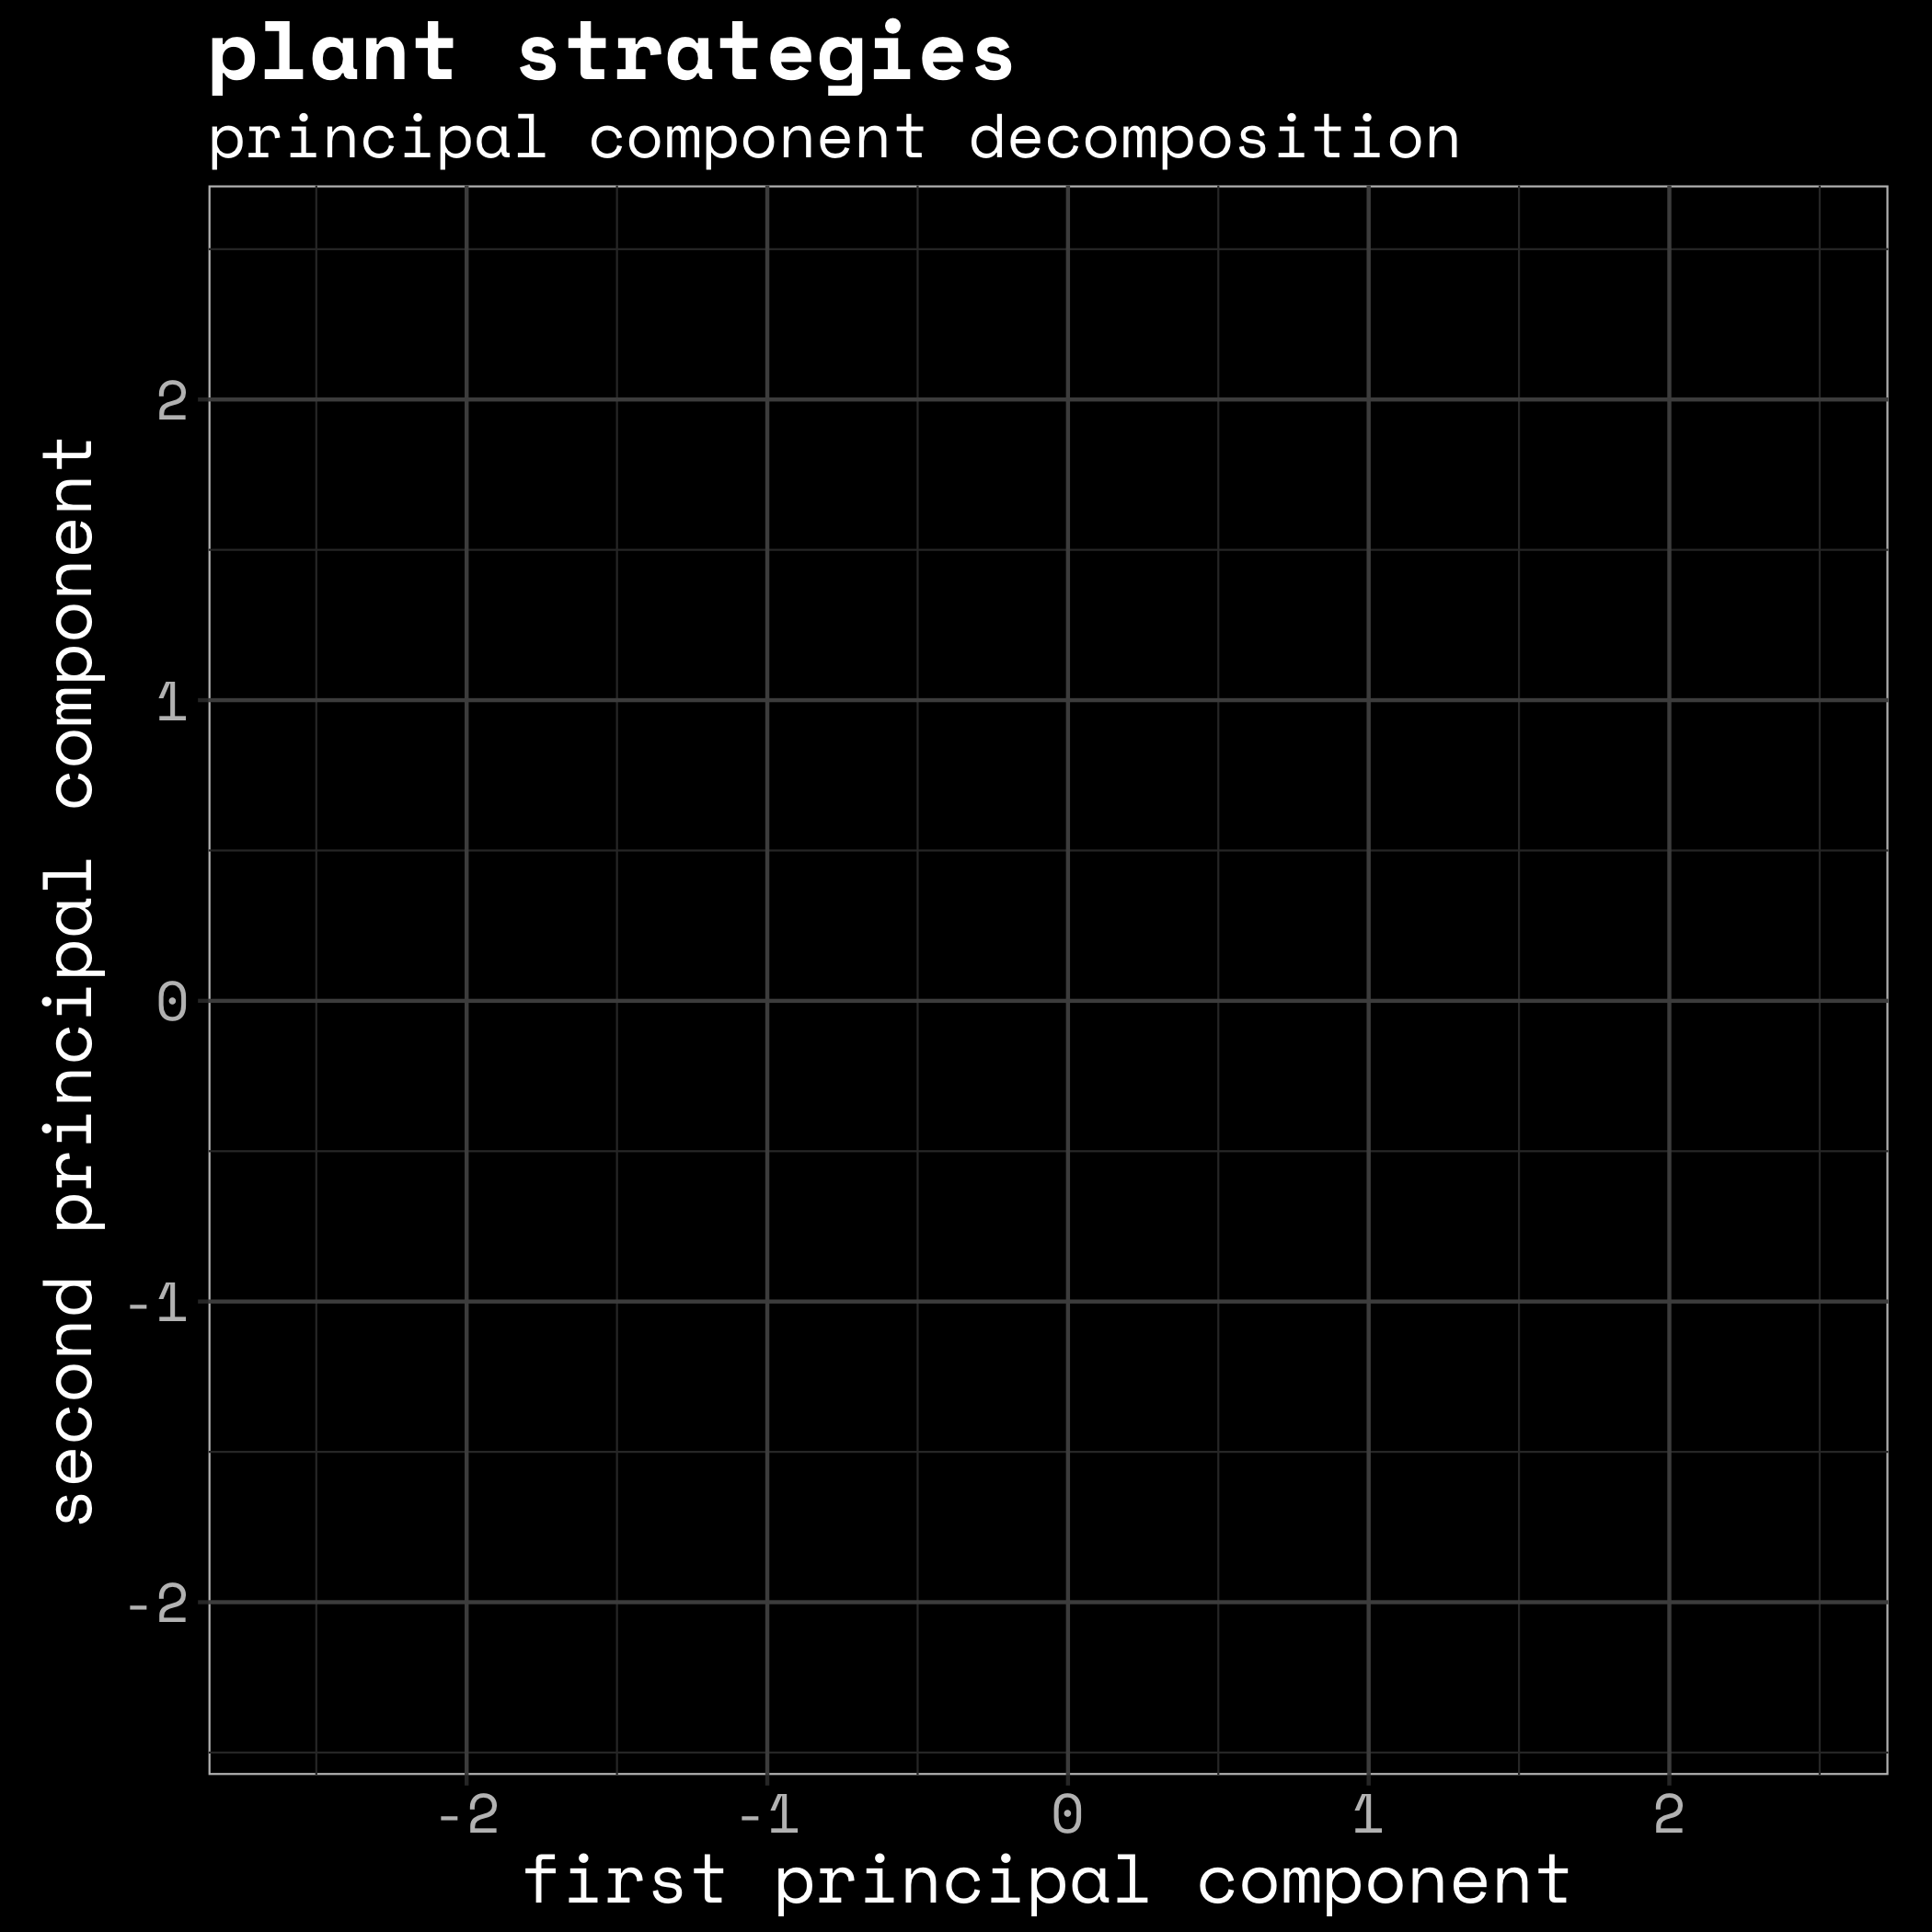

Slide 20
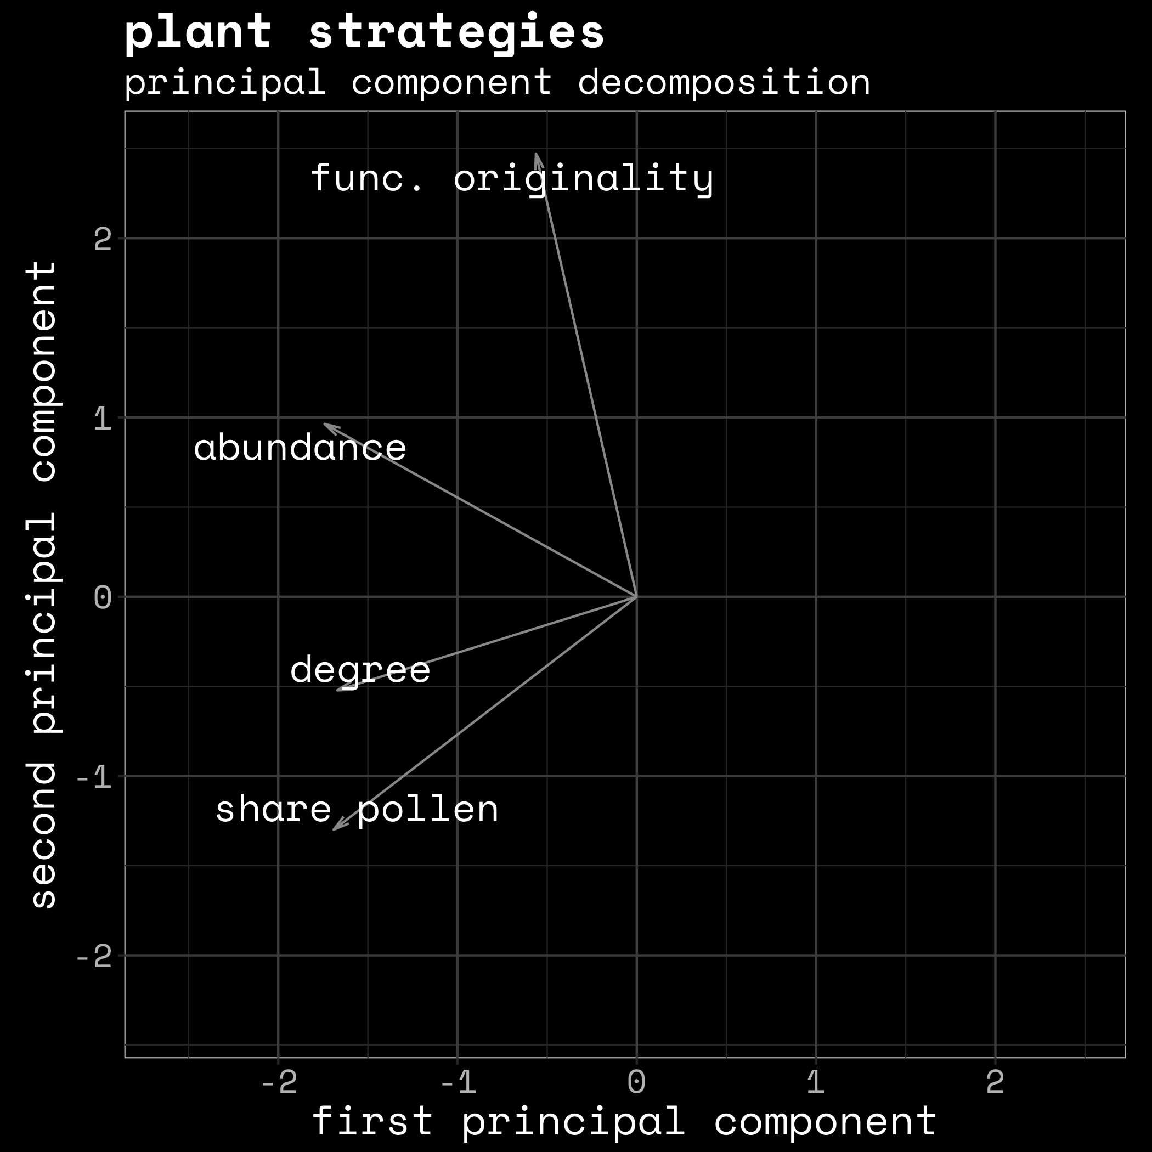

Slide 21
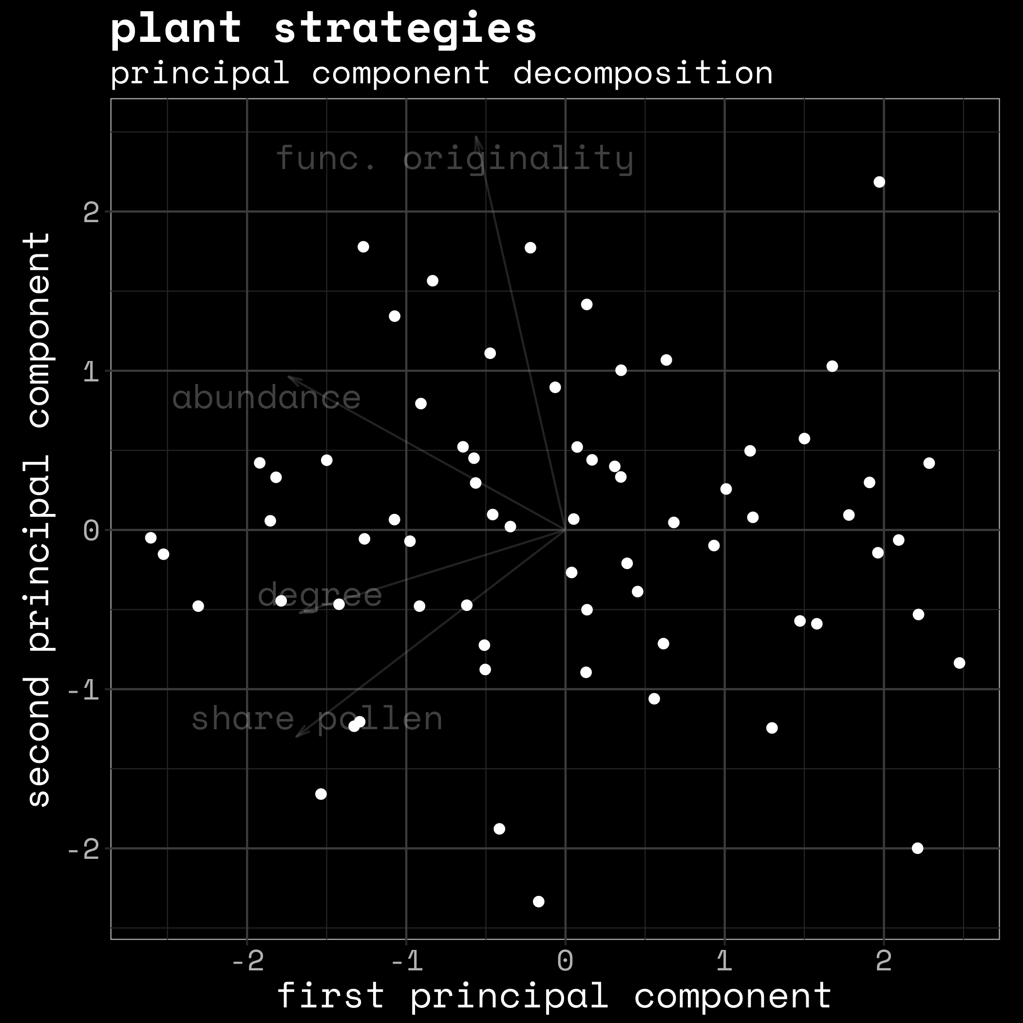

Slide 22
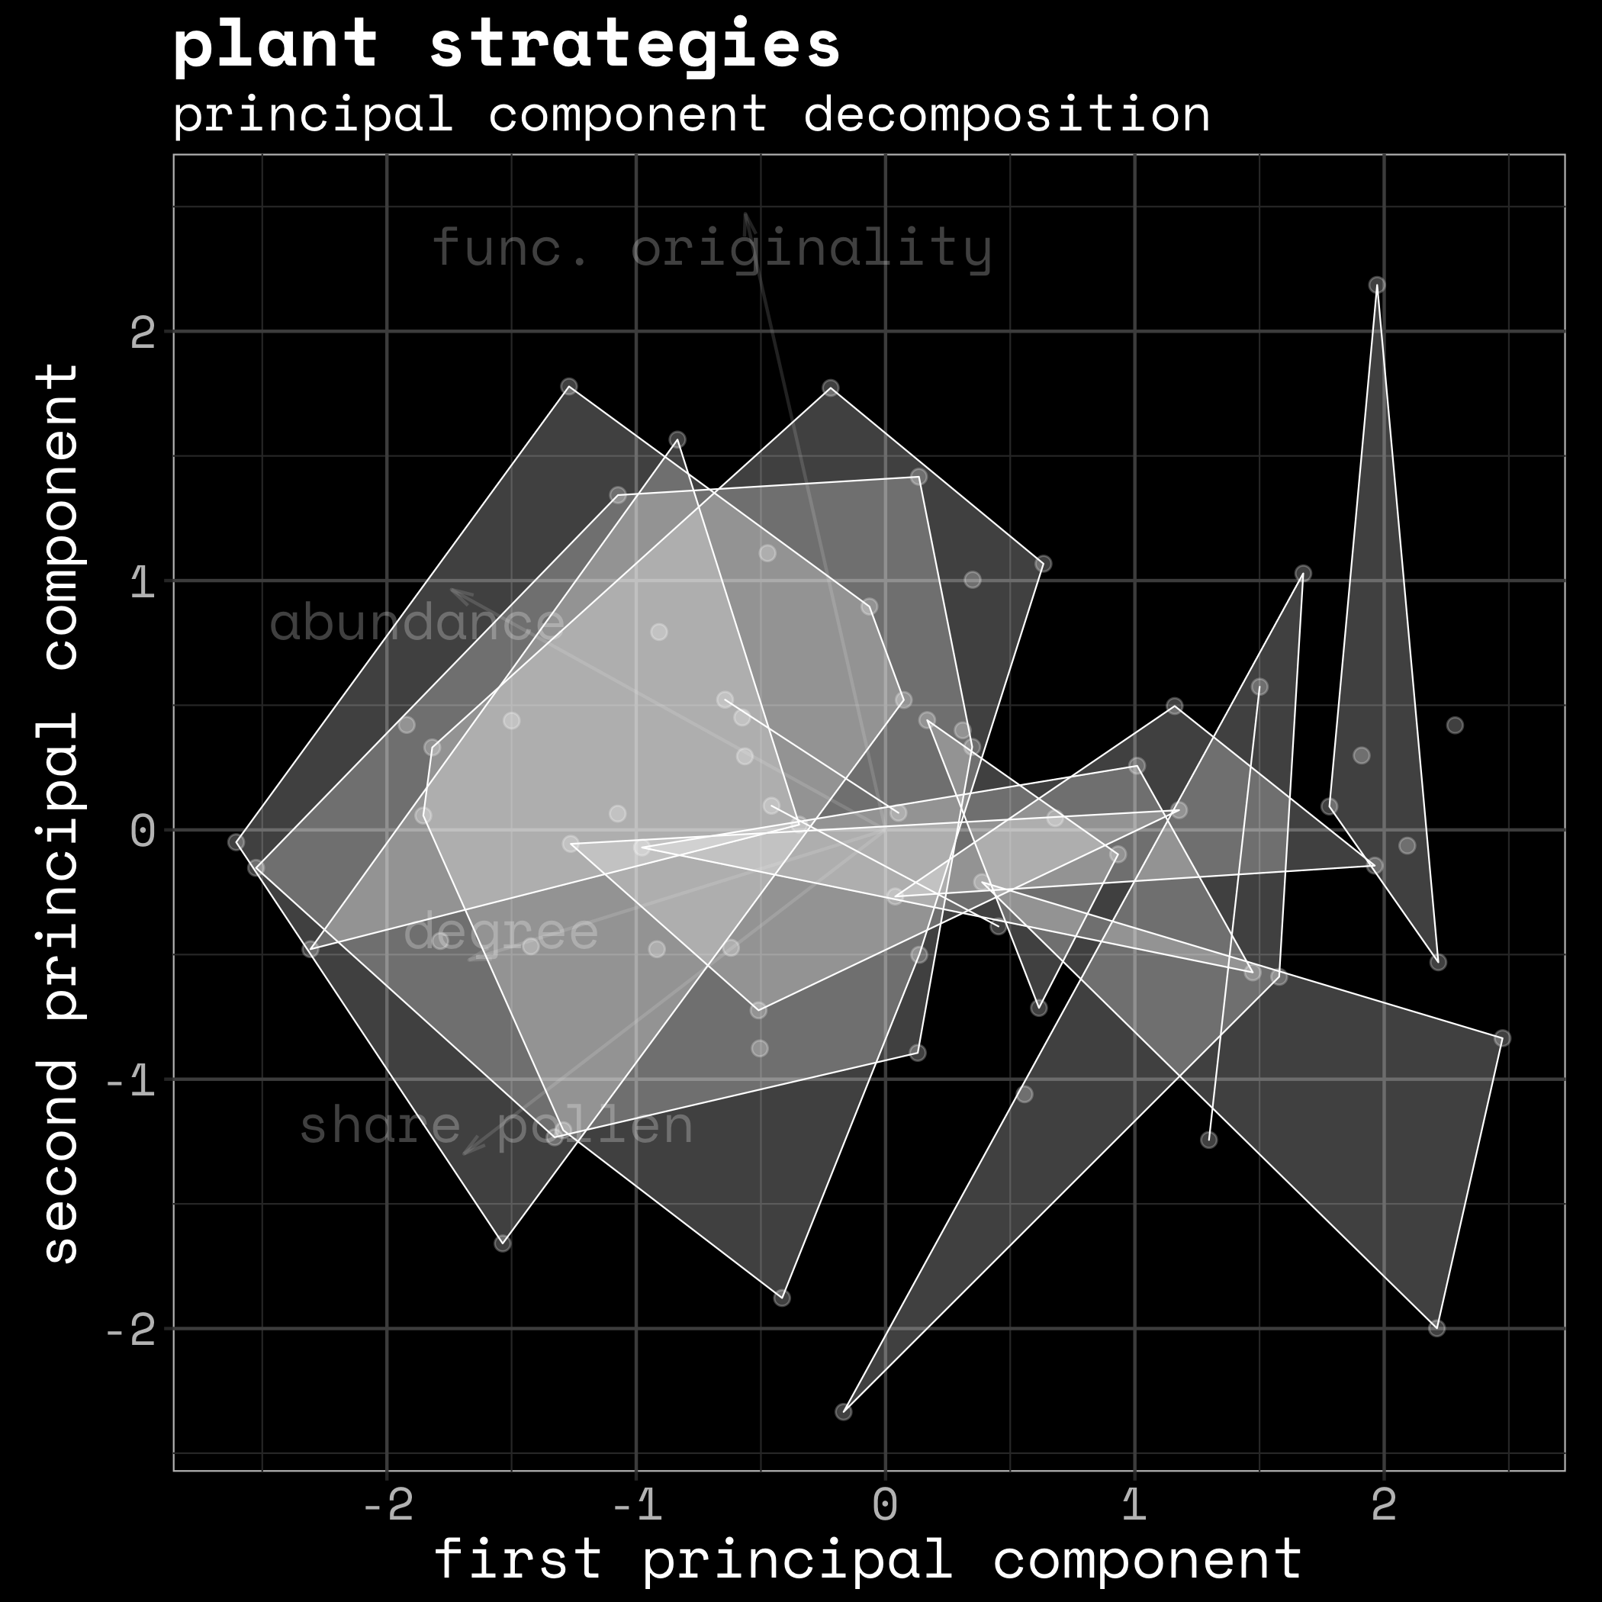

Slide 23
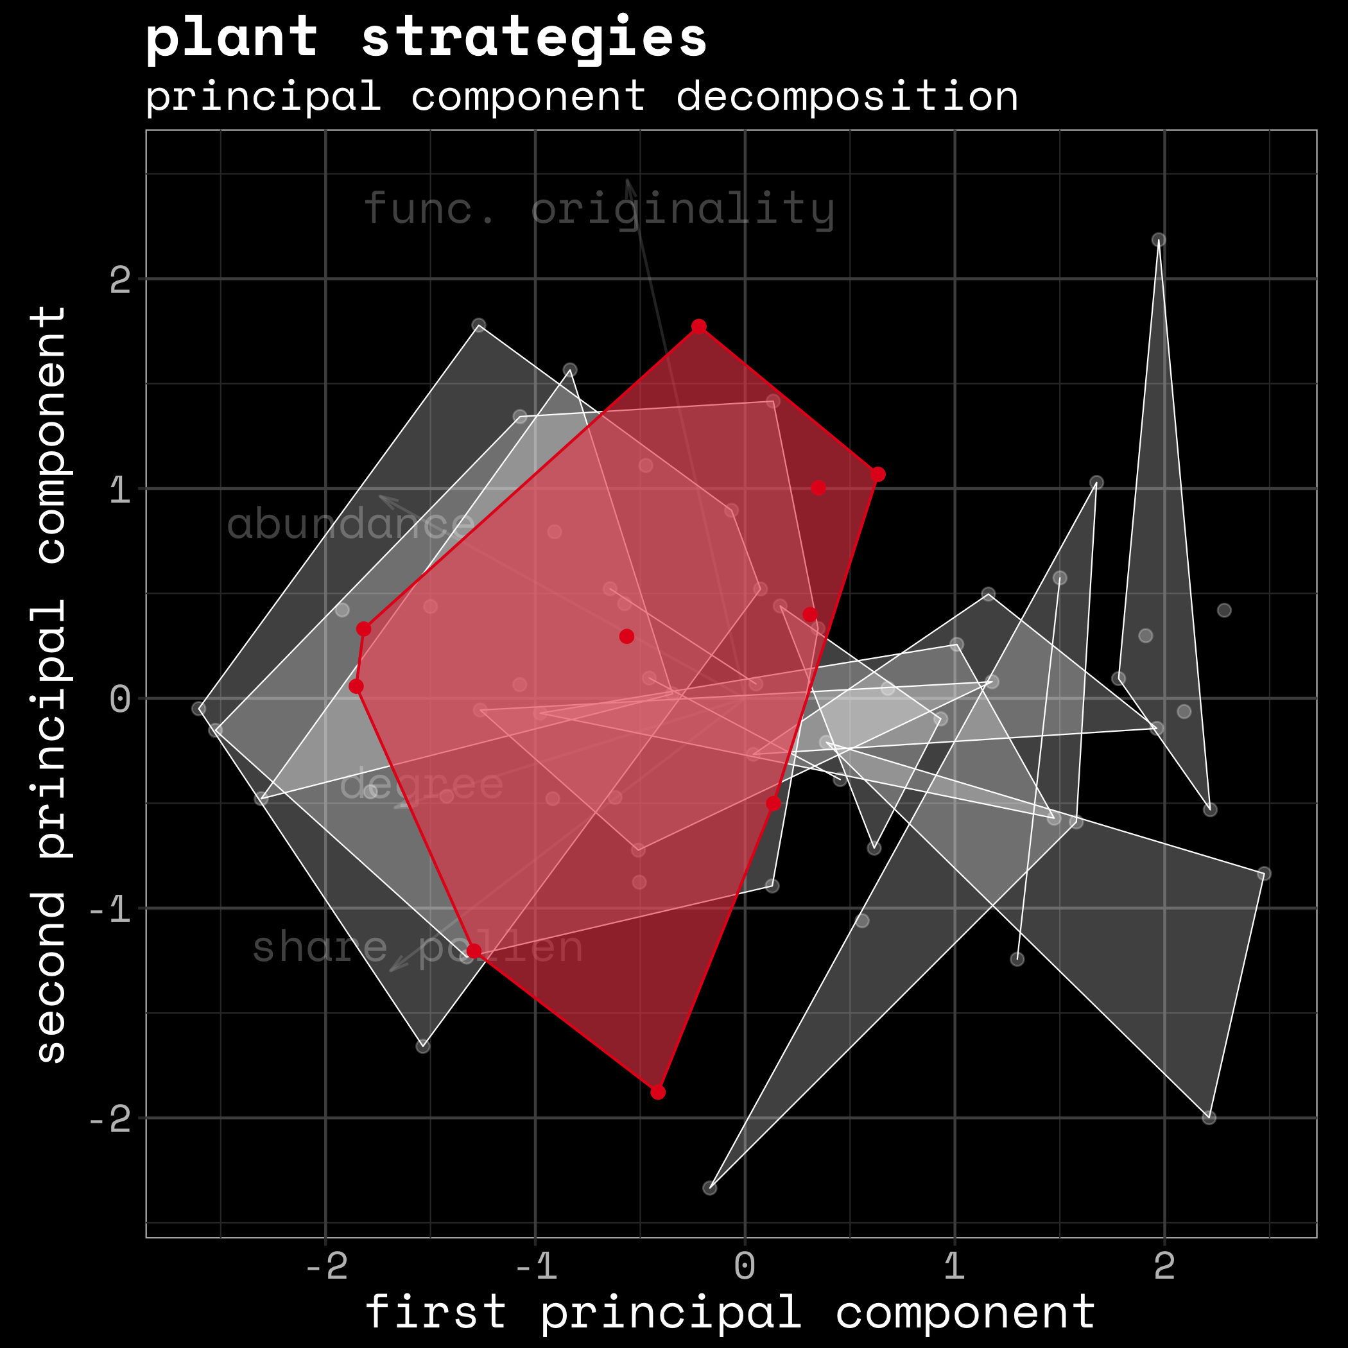
welted thitsle

Slide 24
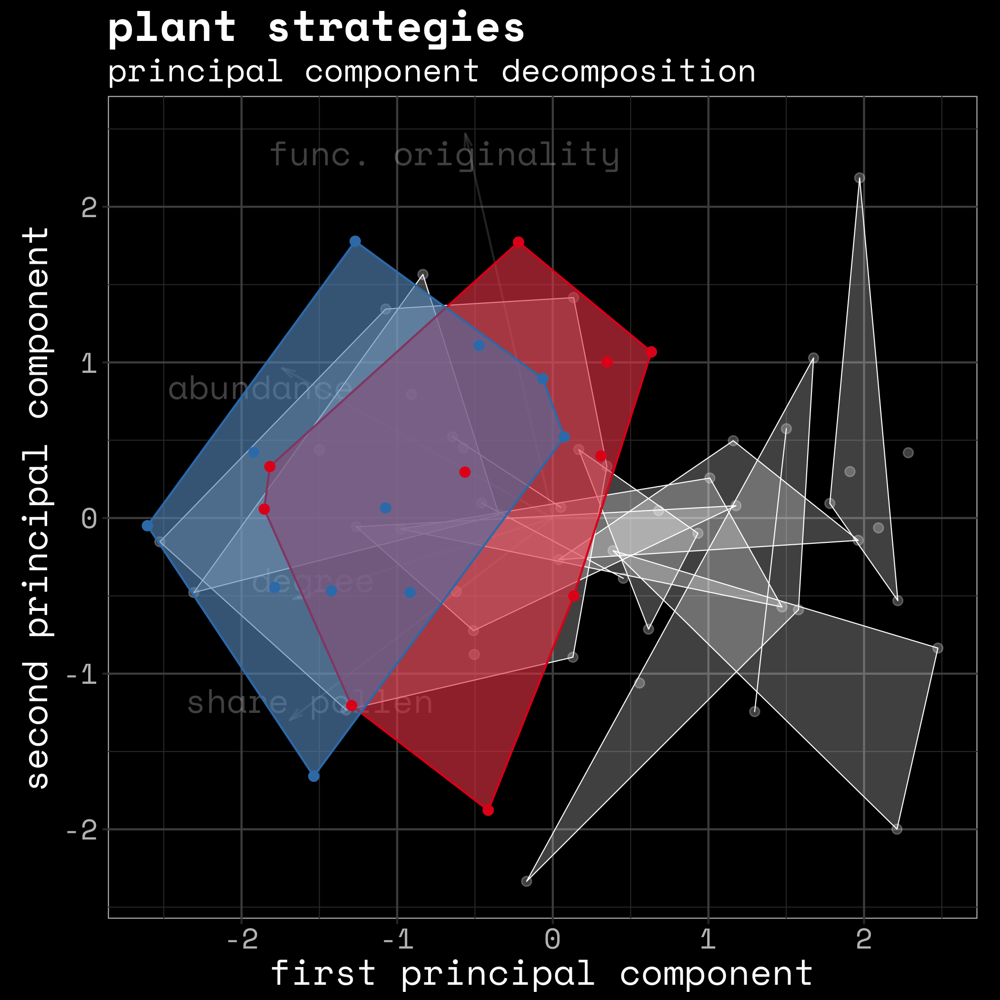
welted thitsle
mediterranean mustard

Slide 25
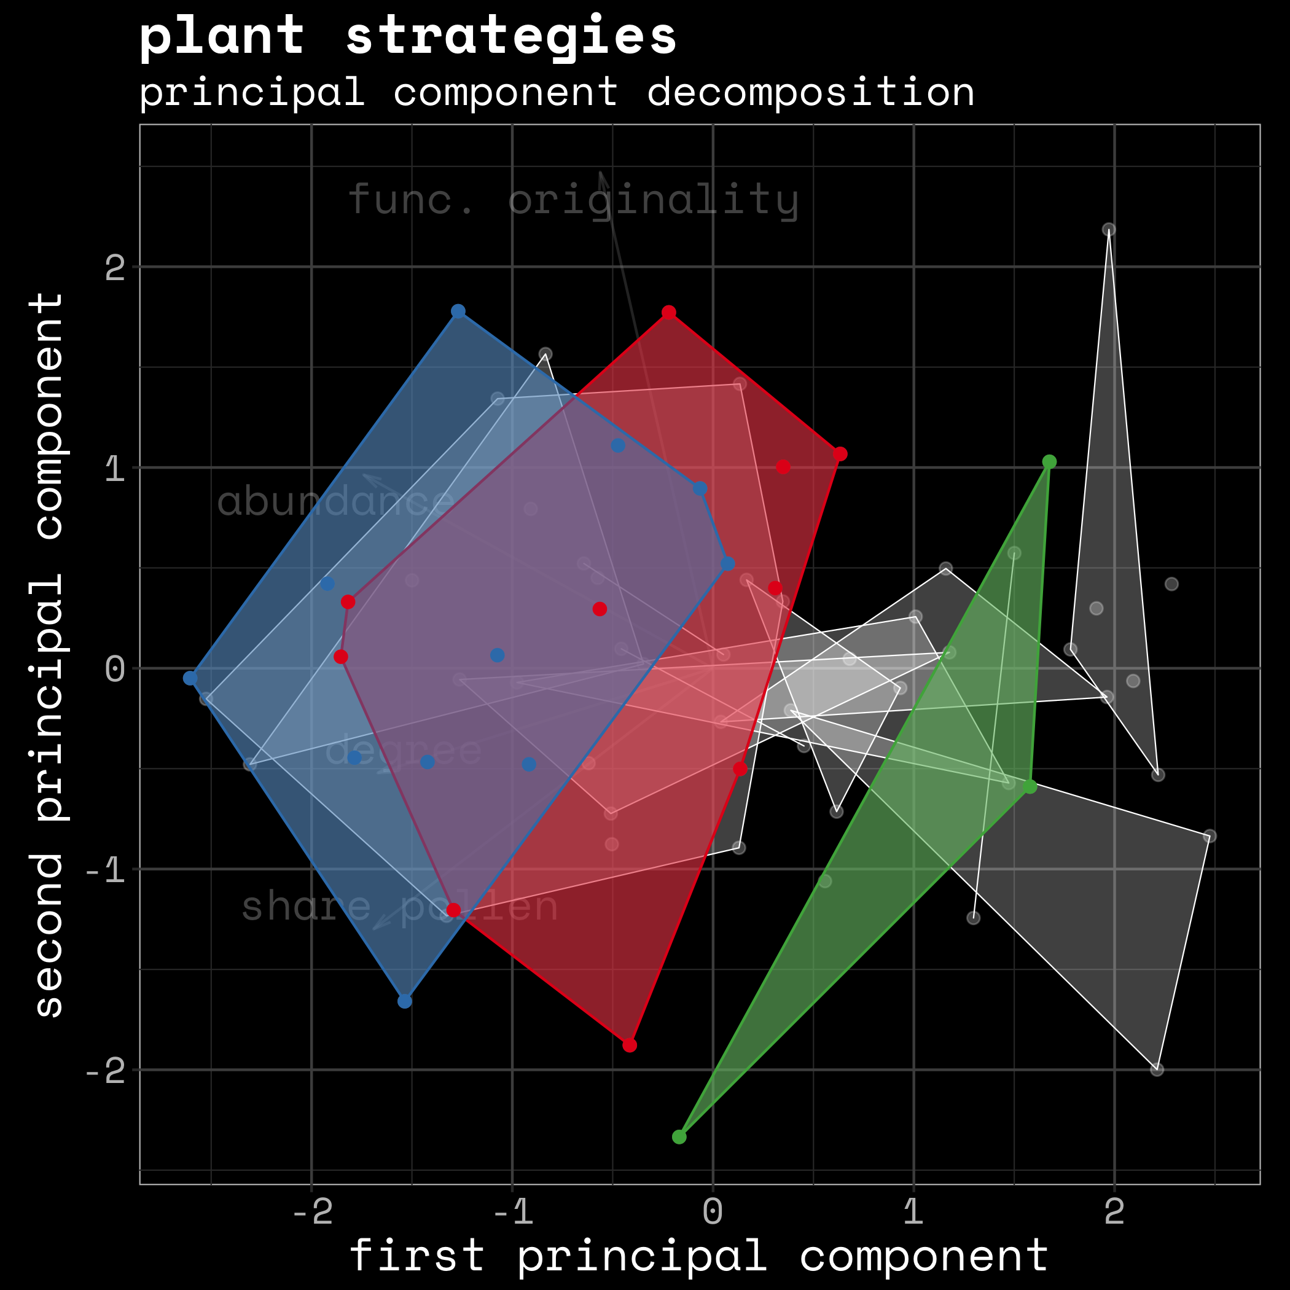
welted thitsle
mediterranean mustard
globemallow

Slide 26
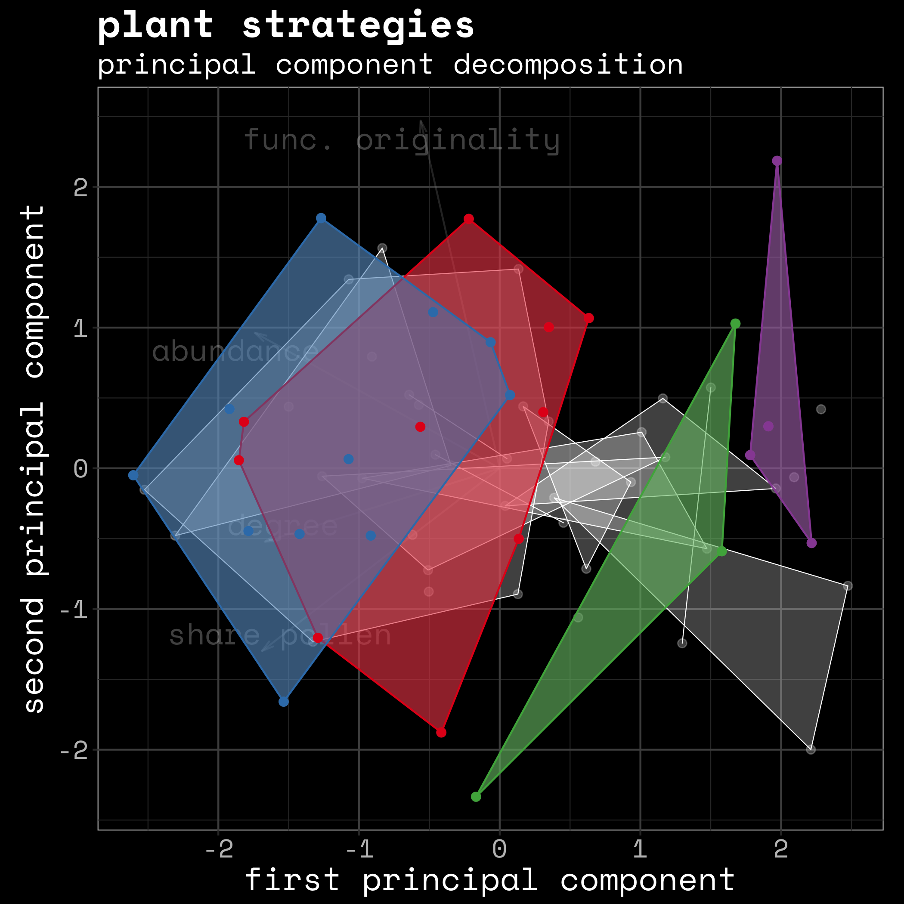
welted thitsle
mediterranean mustard
globemallow
vervain

Slide 27
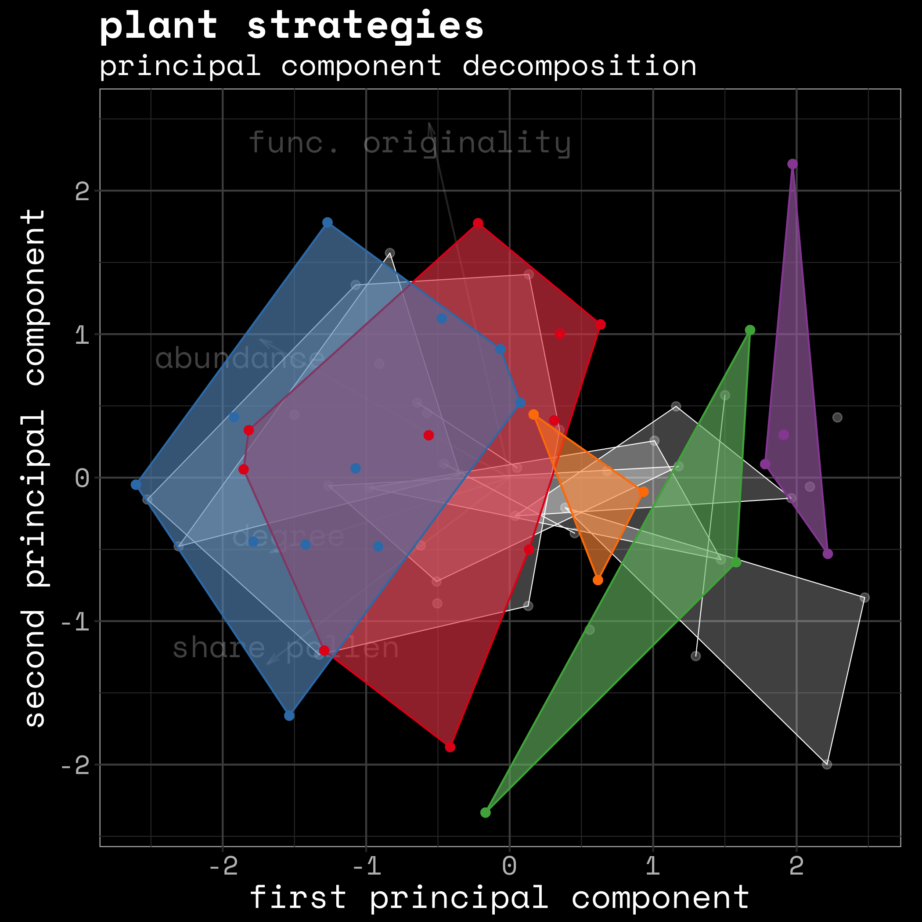
welted thitsle
mediterranean mustard
globemallow
vervain
pennyroyal

Slide 28

take home
communities are not species pairs
effect of trade-off is small in communities
the more the merrier
density mechanisms dominate pollen competition
being different is good
functional originality improves pollination serv.
plants can be flexible
strategies to compete differ between communities
Notes:
body parts, abundance, dependency on animal pollination

Slide 29
take home
communities are not species pairs
effect of trade-off is small in communities
the more the merrier
density mechanisms dominate pollen competition
being different is OK
functional originality improves pollination serv.
plants can be flexible
strategies to compete differ between communities
Notes:
body parts, abundance, dependency on animal pollination

Slide 30
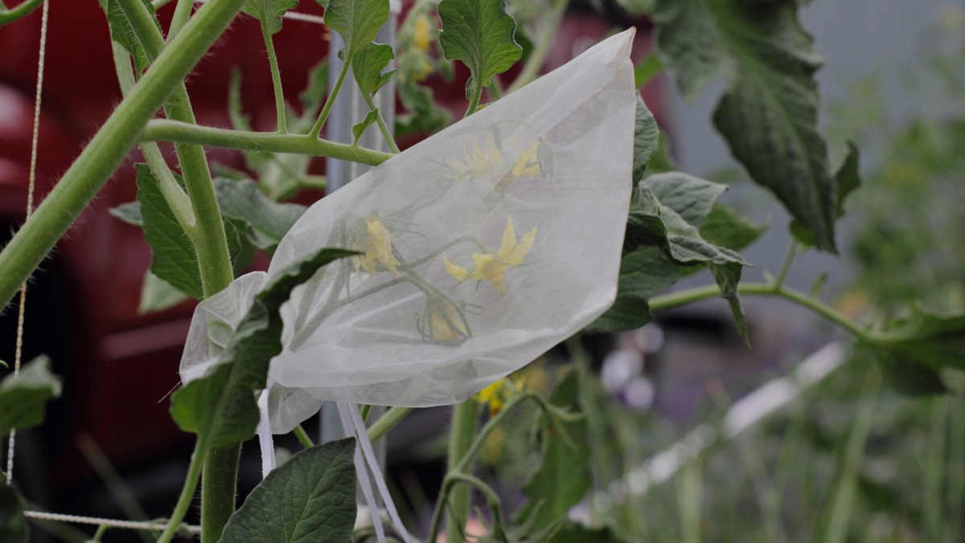
Helena Jole

Slide 31
